Slide 1
Review

Slide 2
Statistics Types
Descriptive – describe the data, create a picture of the data
Mean – average of all scores
Mode – score that appears the most often
Median – score that appears in the middle when arranged in order
Variance – average distance of scores from the mean
Standard deviation – standardized variance (or standard average distance from the mean)

Slide 3
Data Set
To get all descriptive information at once
Two different ways
Open the basic data set.sav
Analyze > frequencies
OR
Analyze > descriptive statistics

Slide 4
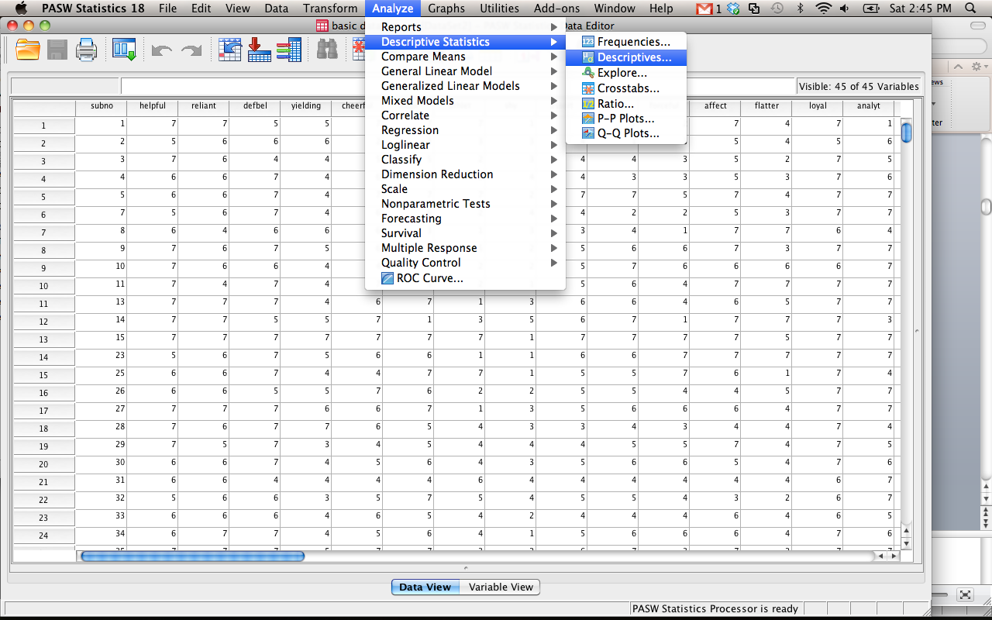

Slide 5
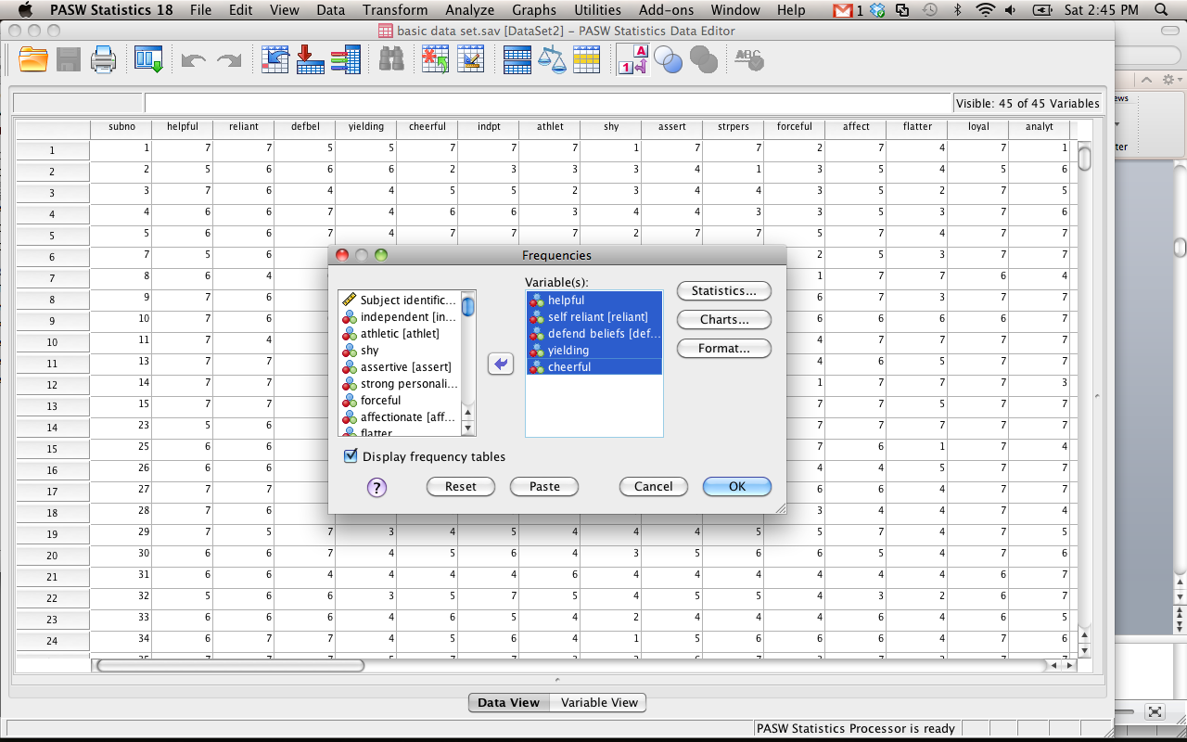

Slide 6
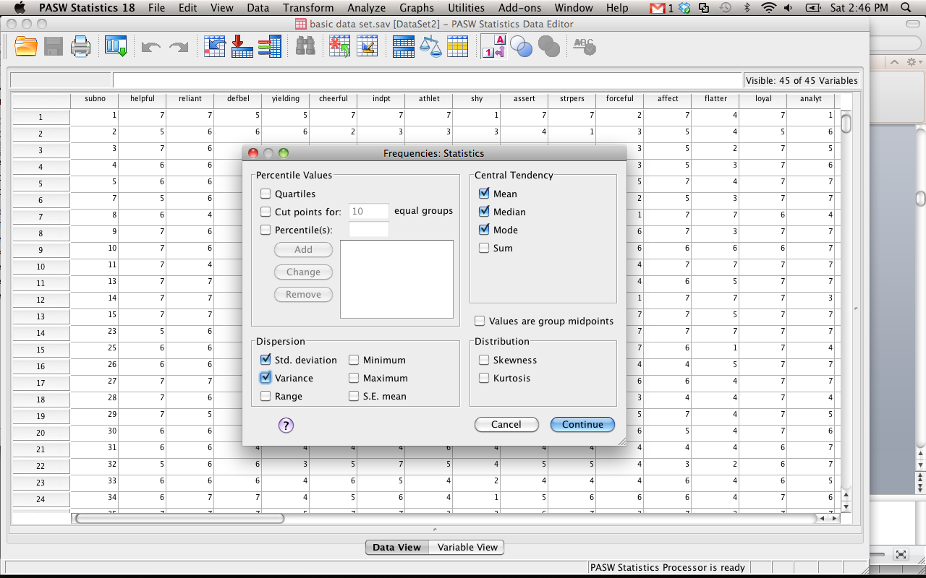

Slide 7
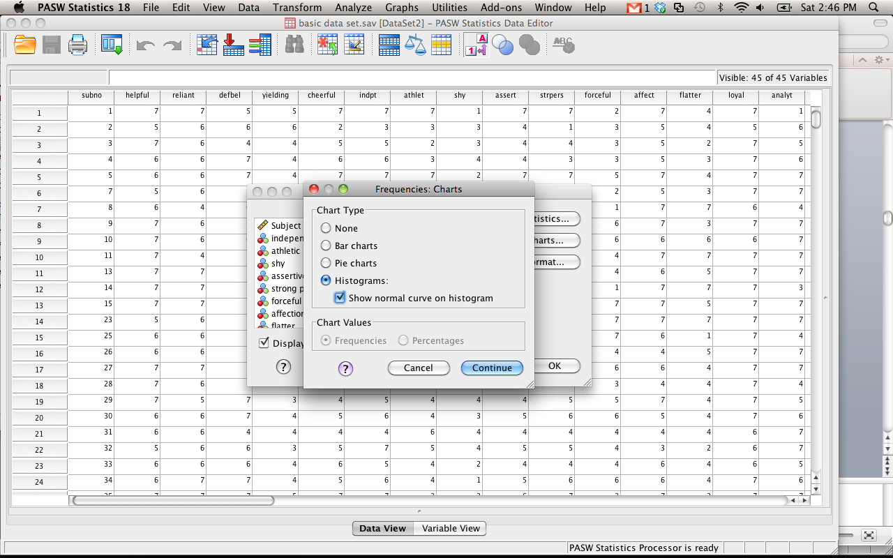

Slide 8
Frequency Output
First box gives you:
Mean, median, mode, variance, standard deviation
Next set of boxes are frequency tables
List all the scores and how many of them fall into those scores
On this output, we also asked for histograms

Slide 9
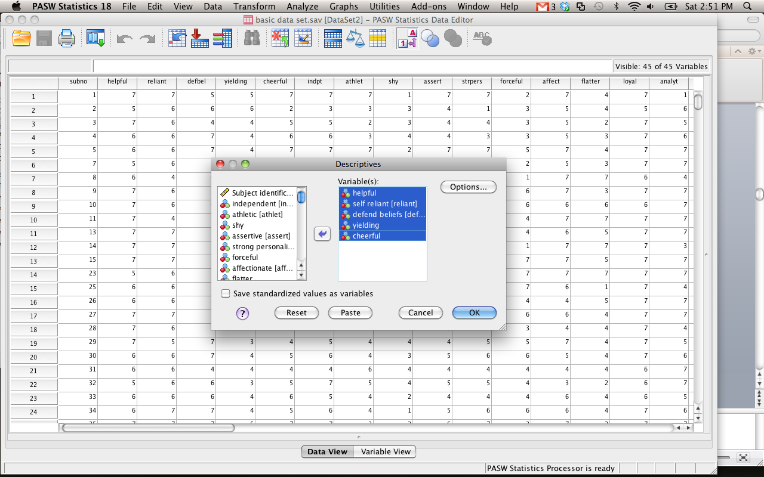

Slide 10
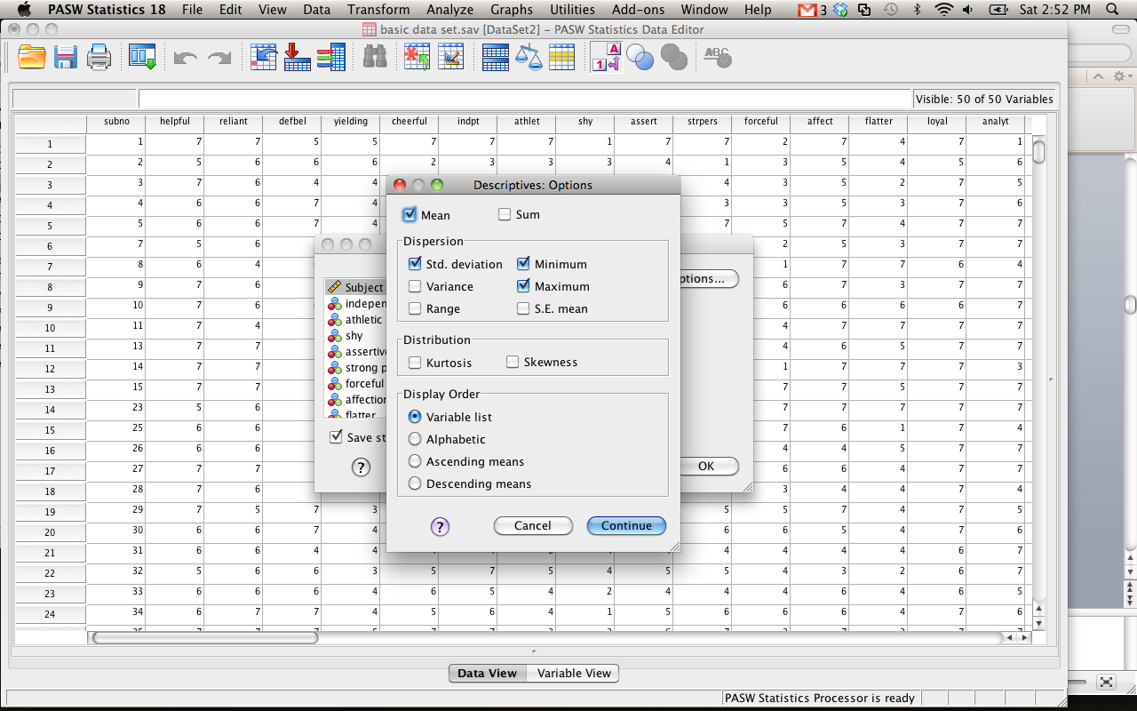

Slide 11
Descriptives output
Will only give you:
Mean, standard deviation, variance (if you ask), min and max
SE = standard error of mean or standard deviation of the distribution of samples
Does not do median, mode
Will give you standardized scores (z-scores)

Slide 12
Statistics Types
Inferential statistics
Infer information about the data.
Tells you if your data is different from some known sample OR some other data set.
Parametric versus non-parametric
Parametric – used on interval and ratio data, numbers that are continuous in nature
Requires more assumptions
Non-parametric – used on all data types (especially nominal, categorical)
Does not require same assumptions

Slide 13
Hypothesis Testing
“Surely God loves p<.06 just as much as p<.05” – Jacob Cohen
Hypothesis Tests
Null (want to reject this)
All groups are equal, IVS and DVS unrelated, Expected=Observed, etc.
Alternative
Groups are not equal, one mean > another mean, expected doesn’t equal observed etc.

Slide 14
Hypothesis Testing
In basic statistics:
Usually you learn about cut off scores and the score has to be greater than the cut off score to be significant
You are finding the point in which the probability of that score is less than 5% or 1%.

Slide 15
Hypothesis Testing
Another way to think about this:
Instead just use exact p-values.
SPSS will give you the p-value. You want your p-values to be less than .05 or .01.
Eliminates the need for cut off scores (sort of)
Not for z-tests
Not for post hoc tests
Not for one tailed tests
Always uses a two-tailed test (if applicable).

Slide 16
Univariate Statistics
Univariate – 1+ IVs to 1 DV
Most common used
Limit you to only one DV
Types
Z
T-tests
ANOVA**
Correlation
Regression**
Chi-Square

Slide 17
Univariate
Z-tests
Types:
X-score
Z-test (single sample)
Assumptions
Normal distributions

Slide 18
Z-score example
A personnel psychologist has to decide which of three employees to place in a particular job that requires a high level of coordination. All three employees have taken tests of coordination, but each took a different test. Employee A scored 15 on a test with a mean of 10 and a standard deviation of 2; Employee B scored 350 on a test with a mean of 300 and a standard deviation of 40; and Employee C scored 108 on a test with a mean of 100 and a standard deviation of 16. (On all three tests, higher scores mean greater coordination.)
Who’s the best?

Slide 19
Z-Test example
In a study to see if children from lower socio-economic status (SES) neighborhoods have lower than average test-taking skills, a psychologist administered a standard measure of test-taking skills to a set of randomly chosen children from a low SES neighborhood and found them to have a score of 38. The average score on this measure for the population in general is 50 with a standard deviation of 10. Using the .05 level of significance, what conclusions should be drawn about whether children from low SES neighborhoods have lower test-taking ability?

Slide 20
T-Tests
Types:
Single sample
Dependent
Independent
Assumptions
Normal curves
Equal Variances (homogeneity)

Slide 21
Single Sample Example
A school has a gifted/honors program that they claim is significantly better than others in the country. The national average for gifted programs is a SAT score of 1250.
Use the file single sample t-test here.

Slide 22
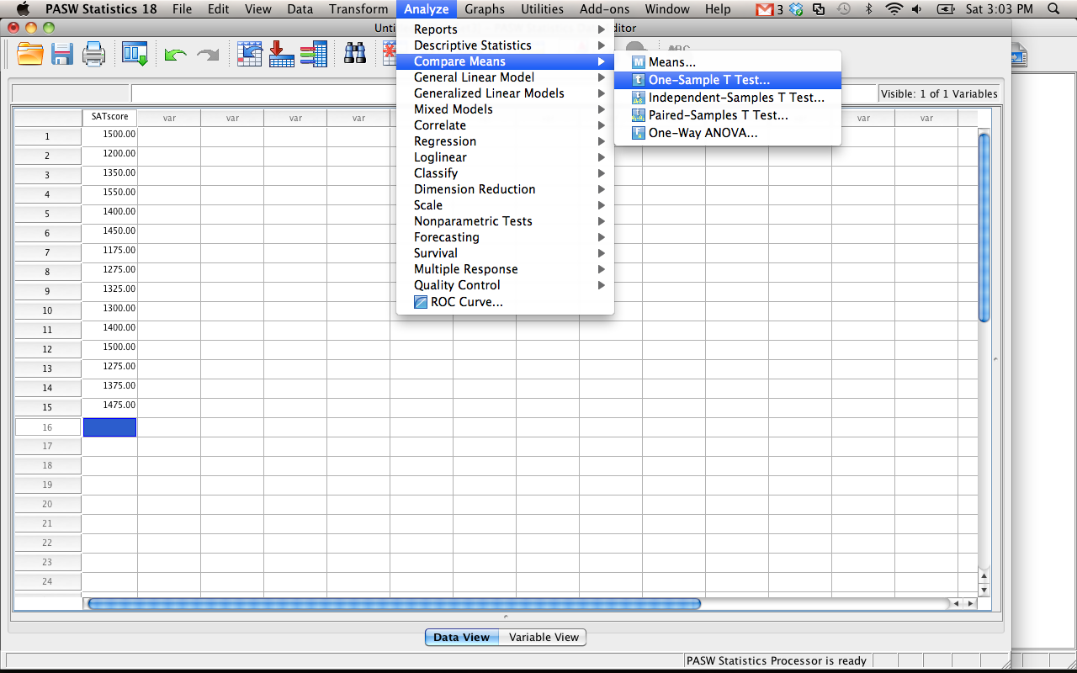

Slide 23
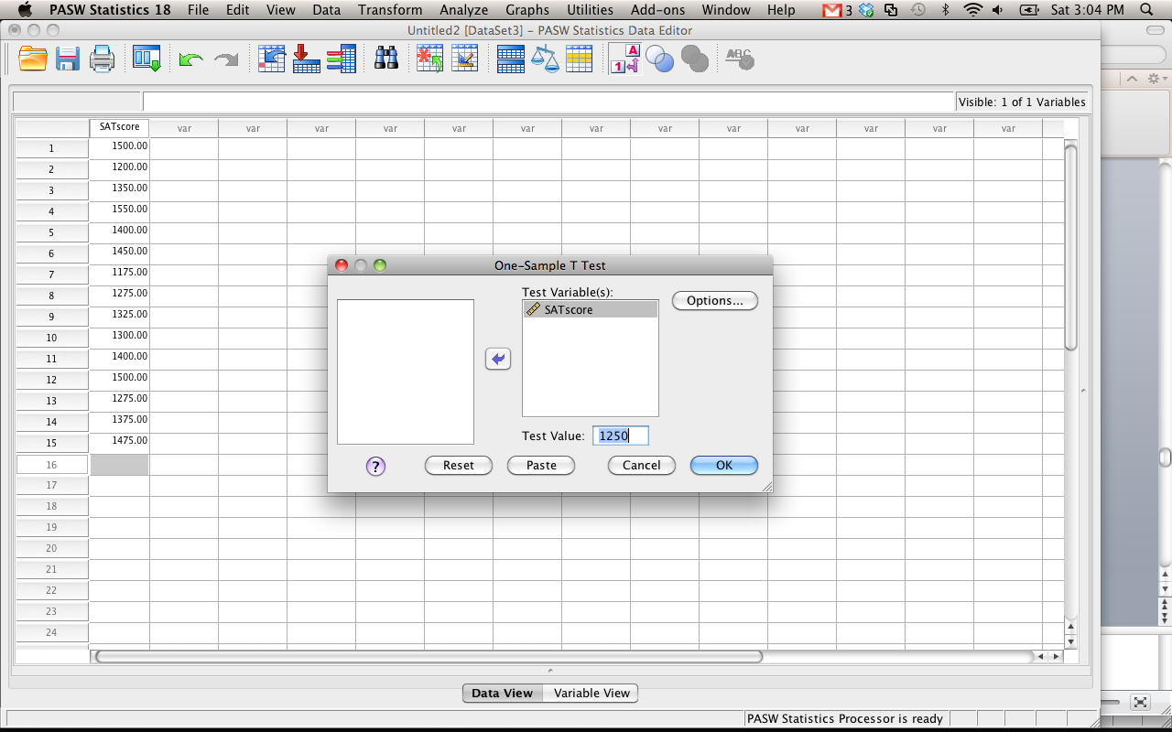

Slide 24
Dependent T-test
In a study to test the effects of science fiction movies on people's belief in the supernatural, seven people completed a measure of belief in the supernatural before and after watching a popular science fiction movie. Participants' scores are listed below with high scores indicating high levels of belief. Using the .01 significance level, carry out a t test for dependent means to test the experimenter's assumption that the participants would be less likely to believe in the supernatural after watching the movie.
Belief-in-Supernatural Scores, Before and After
Watching Science Fiction Movie
Participant Before After
A 3 3
B 5 3
C 9 6
D 6 8
E 7 8
F 5 2
G 4 1

Slide 25
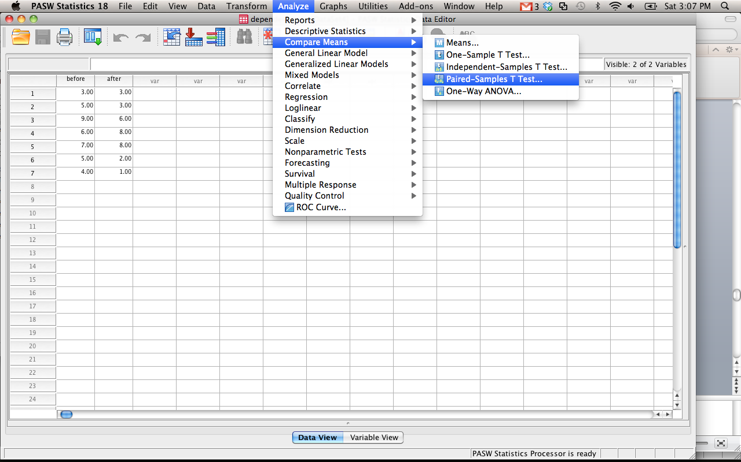

Slide 26
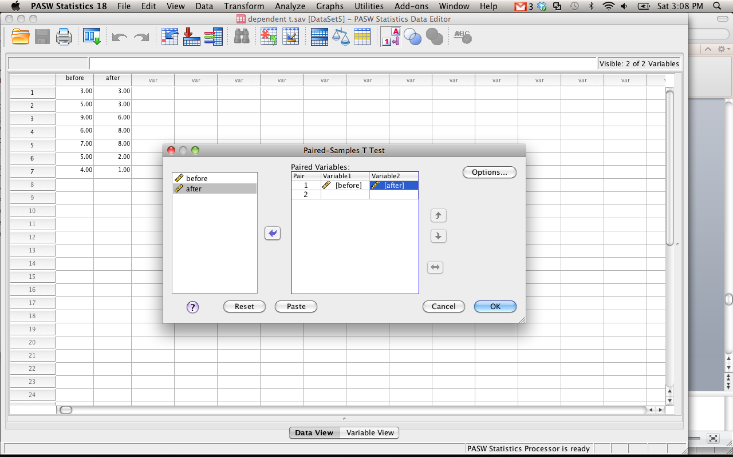

Slide 27
Independent Sample
A forensic psychologist conducted a study to examine whether being hypnotized during recall affects how well a witness can remember facts about an event. Eight participants watched a short film of a mock robbery, after which each participant was questioned about what he or she had seen. The four participants in the experimental group were questioned while they were hypnotized and gave 14, 22, 18, and 17 accurate responses. The four participants in the control group gave 20, 25, 24, and 23 accurate responses. Using the .05 significance level, do hypnotized witnesses perform differently than witnesses who are not hypnotized?

Slide 28
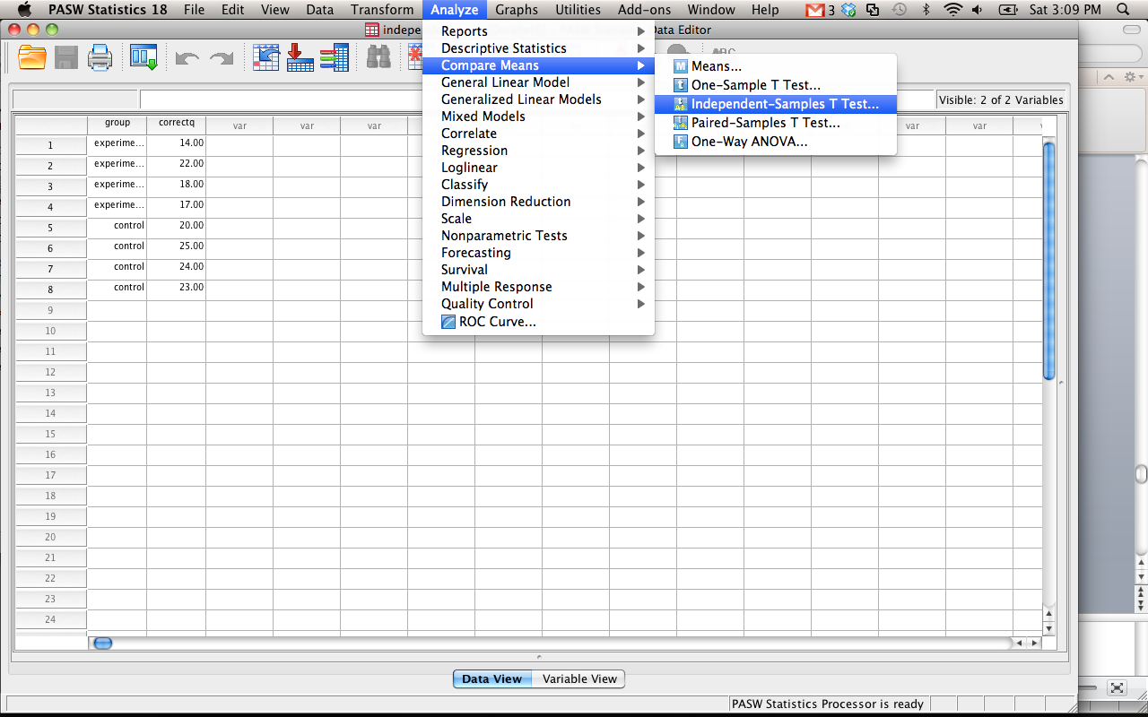

Slide 29
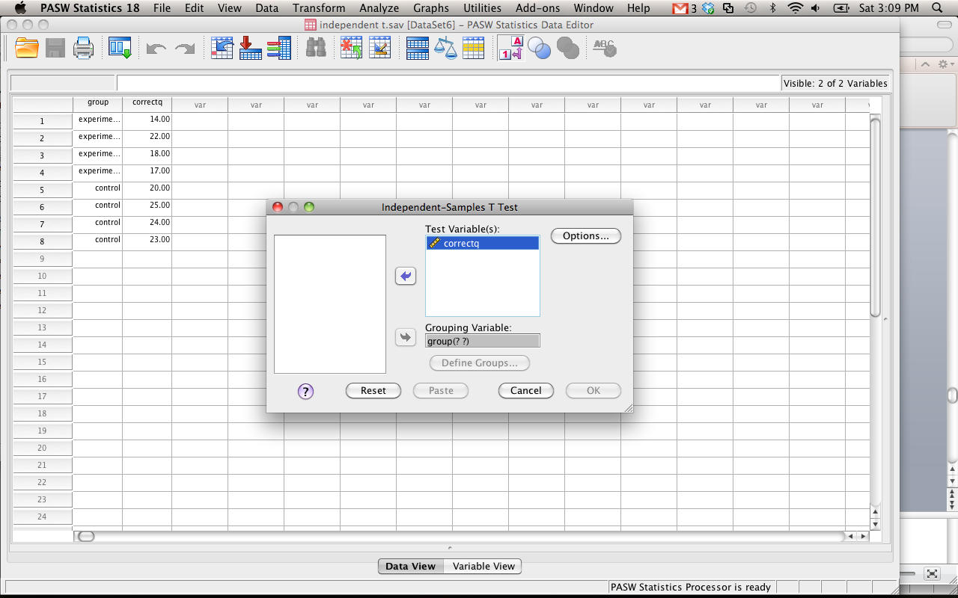

Slide 30
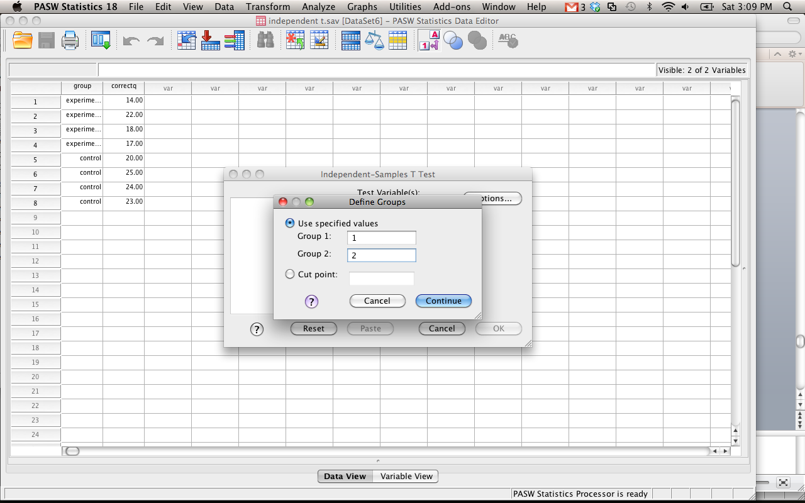

Slide 31
Correlation/Regression
Types
Pearson’s r
Spearman’s rho
Simple Linear Regression
Assumptions
Normality
Homogeneity
Homoscedasticity

Slide 32
Correlation Example
Scores were measured for femininity and sympathy (see correlation.sav). Is there a correlation between those two variables?

Slide 33
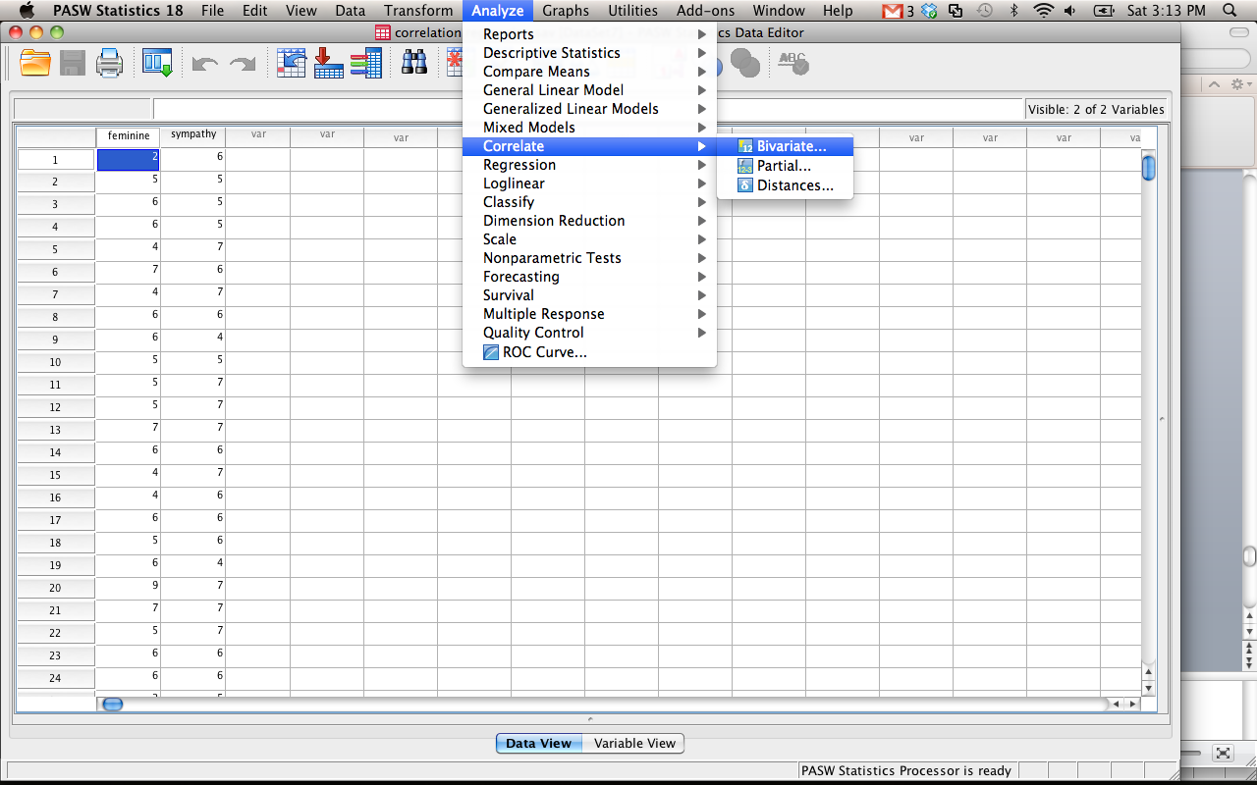

Slide 34
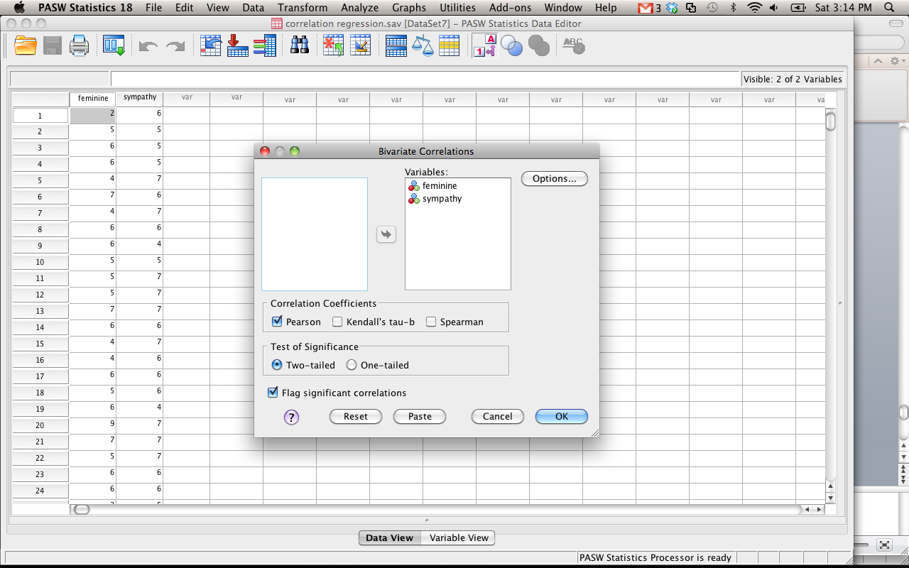

Slide 35
Chi-Square
Note: Chi-square is a non-parametric test.
Assumptions
Each person can only be in one category
Minimal categories

Slide 36
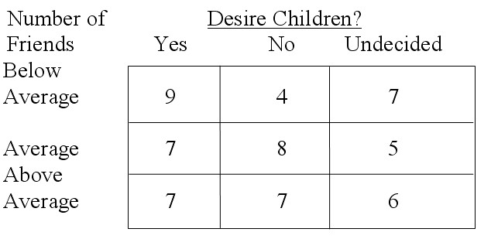
Chi-Square Example
The following table shows results of a survey conducted at a particular high school in which students who had a small, average, or large number of friends were asked whether they planned to have children.

Slide 37
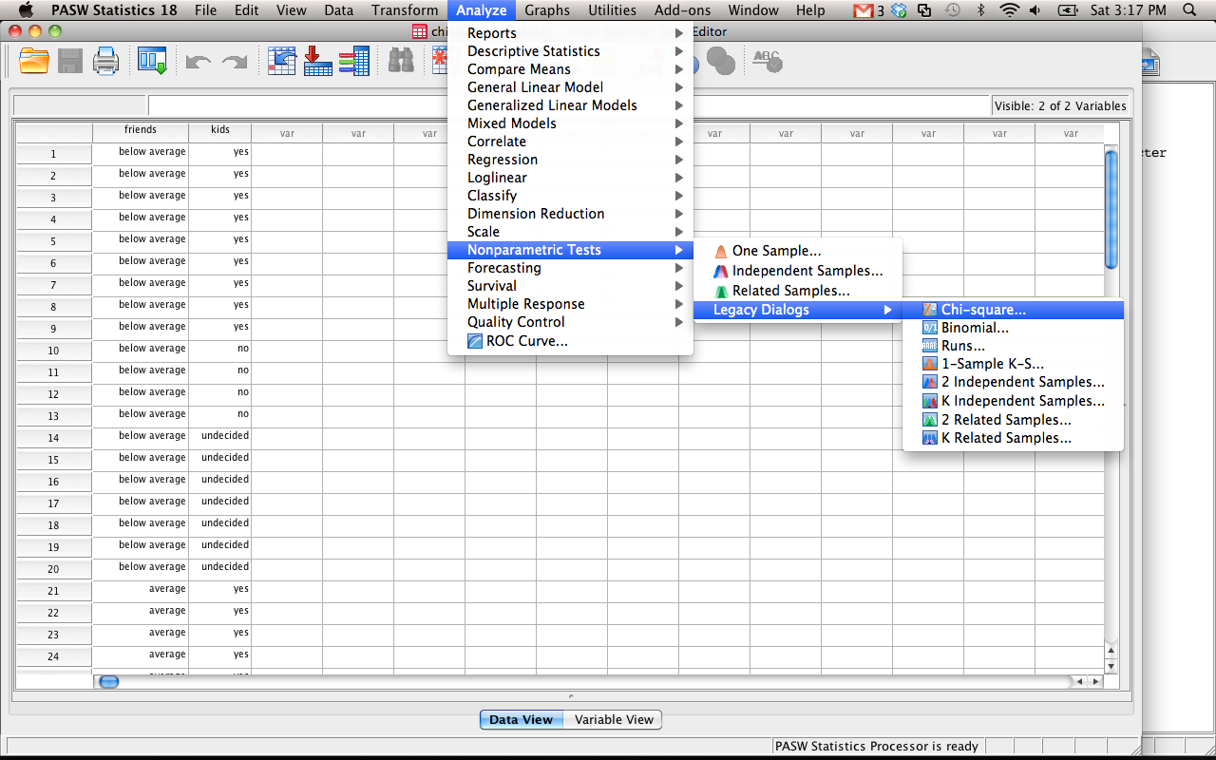

Slide 38
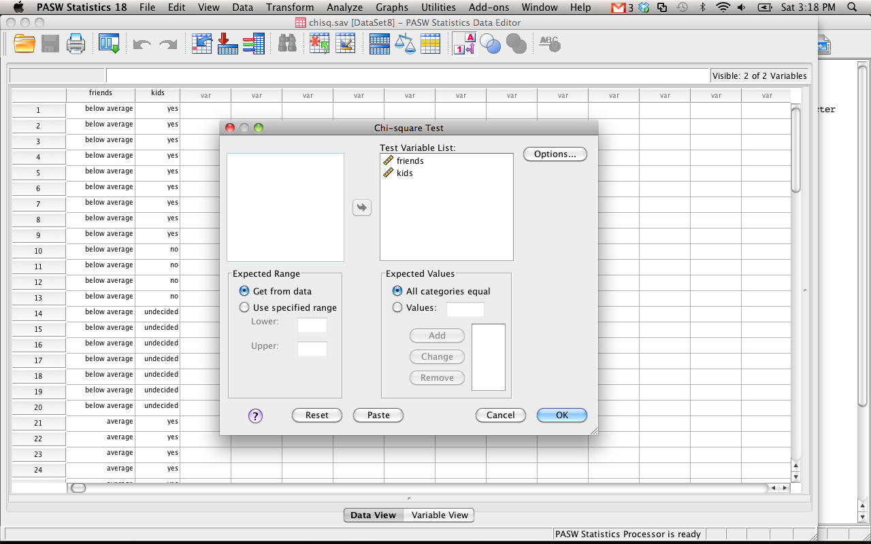

Slide 39
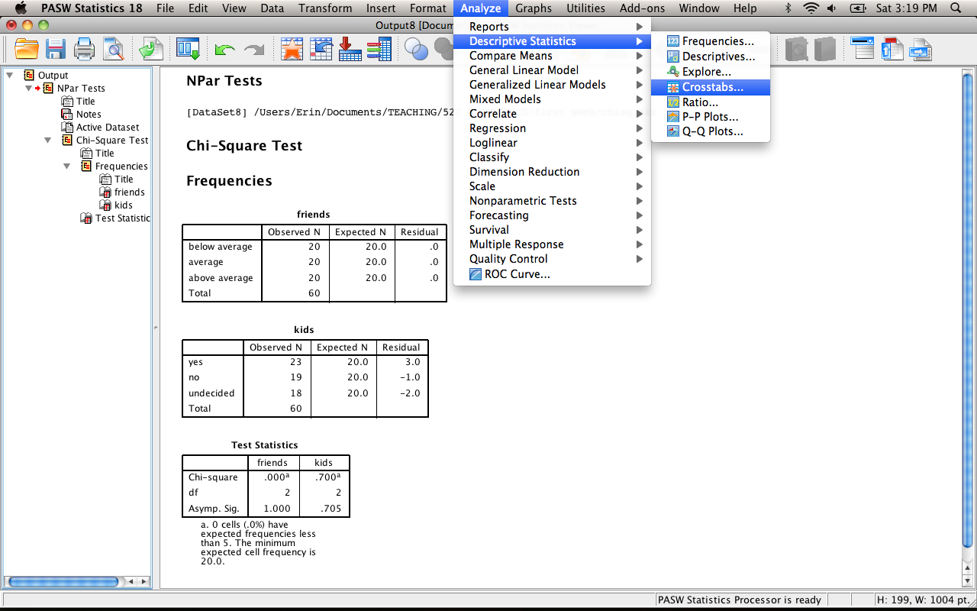

Slide 40
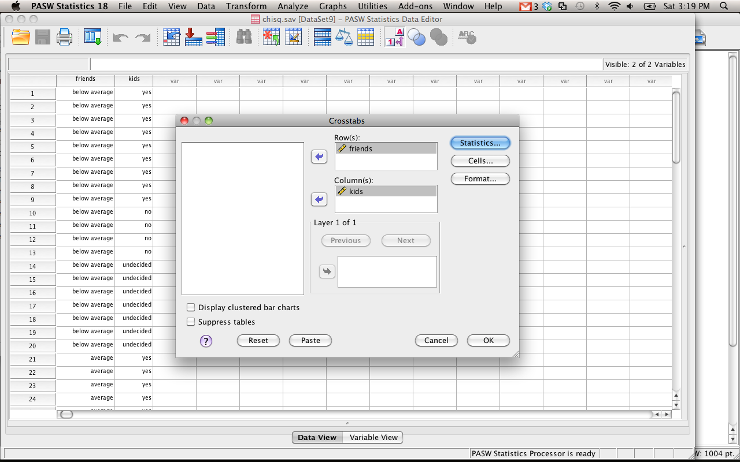

Slide 41
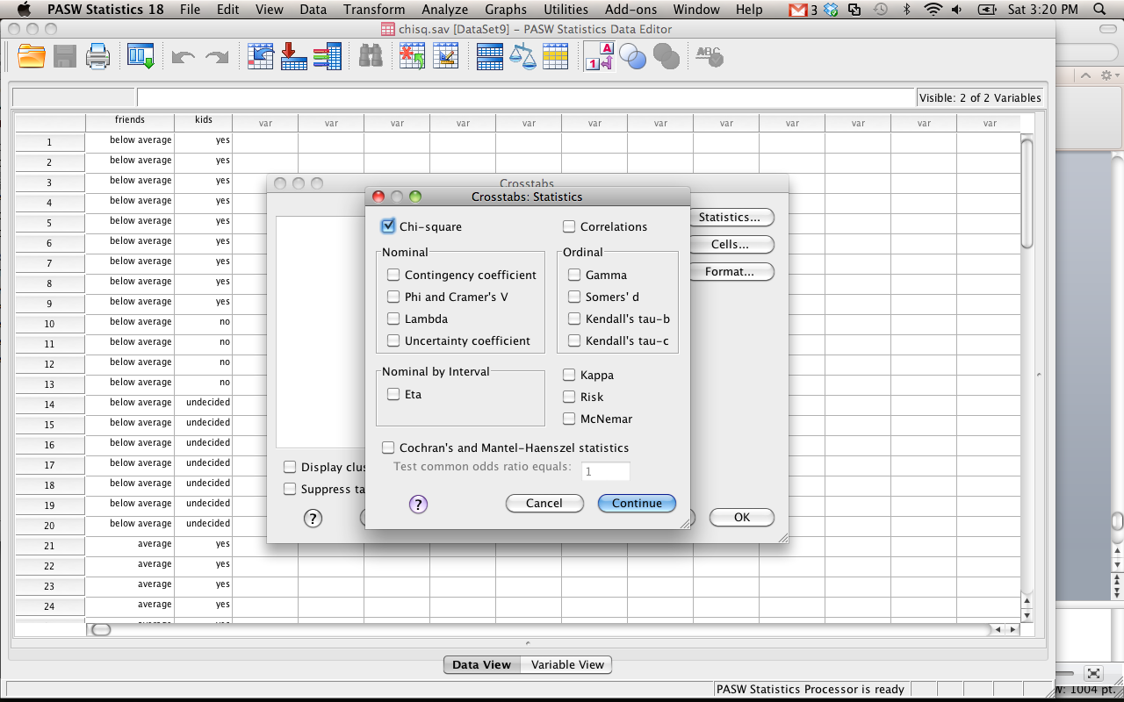

Slide 42
Multivariate Statistics
Multivariate – 1+ IVs to 1+ DVs
Types
MANOVA/MANCOVA
Profile Analysis (repeated measures)
Multiple Regression
Discriminant Analysis
Log Regression
Factor Analysis
Canonical Correlations
Frequency Analysis

